Slide 1


Bharadwaj Y V N S
22-09-2023

Slide 2

Outline
Executive Summary
Introduction
Methodology
Results
Conclusion
Appendix

Slide 3
Executive Summary
Data Collection through API
Data Collection with Web Scraping
Data Wrangling
Exploratory Data Analysis with SQL
Exploratory Data Analysis with Data Visualization
Interactive Visual Analytics with Folium
Machine Learning Prediction
Summary of all results
Exploratory Data Analysis result
Interactive analytics in screenshots
Predictive Analytics result from Machine Learning Lab

Slide 4

Introduction
While other companies charge upwards of 165 million dollars per launch, SpaceX, a revolutionary firm, offers rocket launches, notably Falcon 9 launches, for as little as 62 million dollars. The majority of these savings can be attributed to SpaceX's brilliant idea to reuse the launch's first stage by re-landing the rocket for the following flight. The price will decrease considerably more if this method is repeated. The objective of my project, which I am working on as a data scientist for a firm that competes with SpaceX, is to build a machine learning pipeline to forecast how the first stage will land in the future. The success of this initiative will determine how much to offer SpaceX for a rocket launch.
The problems included: Identifying all factors that influence the landing outcome. The relationship between each variables and how it is affecting the outcome. The best condition needed to increase the probability of successful landing

Slide 5

Section 1

Slide 6
Executive Summary
Data collection methodology:
Data was collected using SpaceX REST API and web scrapping from Wikipedia
Perform data wrangling
Data was processed using one-hot encoding for categorical features
Perform exploratory data analysis (EDA) using visualization and SQL
Perform interactive visual analytics using
Folium and Plotly Dash
Perform predictive analysis using classification models
How to build, tune, evaluate classification models
Methodology

Slide 7
Data Collection
To complement the data obtained through the SpaceX API, we recognized the need to gather additional information that could influence the landing outcome. We turned to web scraping techniques to extract data from external sources.
Our web scraping efforts focused on obtaining data related to meteorological conditions, satellite configurations, and historical space missions. This enriched dataset provides a more comprehensive view of the variables that might impact the landing success of Falcon 9 rockets.

Slide 8

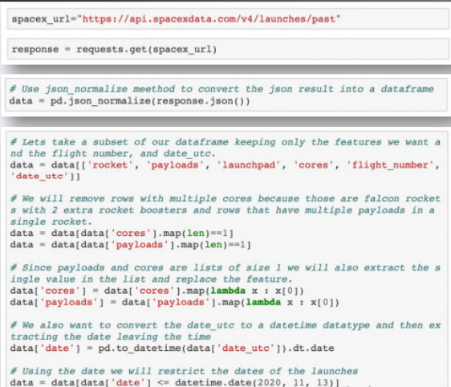
Data Collection – SpaceX API
In this section, we'll outline how we collected crucial data using SpaceX's REST API. Our data collection process was essential in building a robust dataset for our machine learning pipeline.
Key Phrases:
SpaceX REST API: We accessed SpaceX's API to gather real-time data on Falcon 9 launches, including launch details, outcomes, and relevant information.
Data Retrieval: We utilized RESTful HTTP requests to retrieve data from the SpaceX API, ensuring we had access to the most up-to-date information.
Data Validation: To ensure data integrity, we validated and cleaned the retrieved data, addressing any missing or erroneous values.

Slide 9
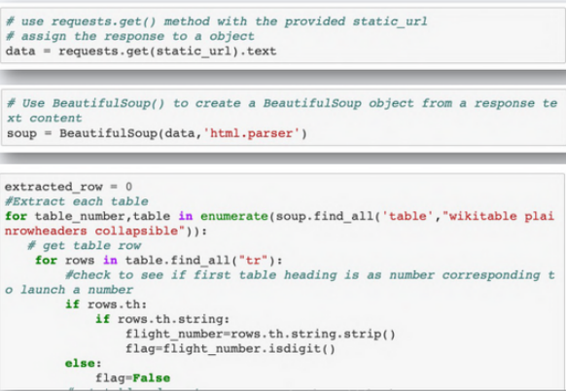
Data Collection - Scraping
Get request for rocket launch data using API .
Use json_normalize method to convert json result to dataframe .
Performed data cleaning and filling the missing values.
Request the Falcon9 Launch Wiki page from url.
Create a BeautifulSoup from the HTML response.
Extract all column/variable names
from the HTML header.

Slide 10

Data Wrangling
For processing the data, we will first calculate the number of launches on each site, then calculate the number and occurrence of mission outcome per orbit type.
We then create a landing outcome label from the outcome column.
This will make it easier for further analysis, visualization, and ML. Lastly, we will export the result to a CSV.

Slide 11
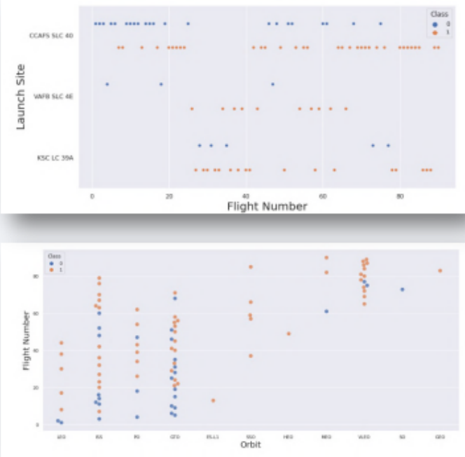
EDA with Data Visualization
The association between the variables, such as between the Payload and Flight Number, was first determined using a scatter graph.
Launch Site and Flight Number.
The launch pad and payload.
Orbital Type and Flight Number.
Payload and kind of orbit.
Scatter plots demonstrate the interdependence of qualities. Following the identification of a pattern in the graphs. It is relatively simple to identify the variables that have the most influence on the outcome of the landing.

Slide 12
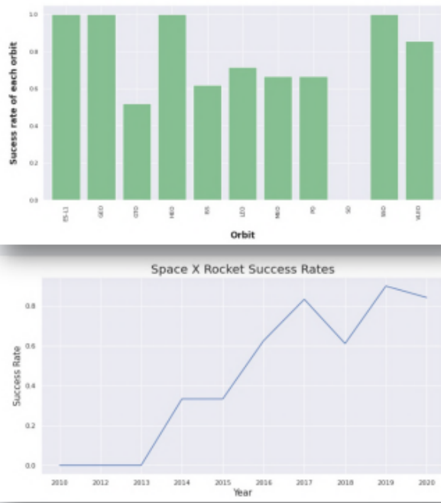
EDA with Data Visualization
Once we get a hint of the relationships using scatter plot. We will then use further visualization tools such as bar graph and line plots graph for further analysis. Bar graphs is one of the easiest way to interpret the relationship between the attributes. In this case, we will use the bar graph to determine which orbits have the highest probability of success. We then use the line graph to show a trends or pattern of the attribute over time which in this case, is used for see the launch success yearly trend. We then use Feature Engineering to be used in success prediction in the future module by created the dummy variables to categorical columns.

Slide 13
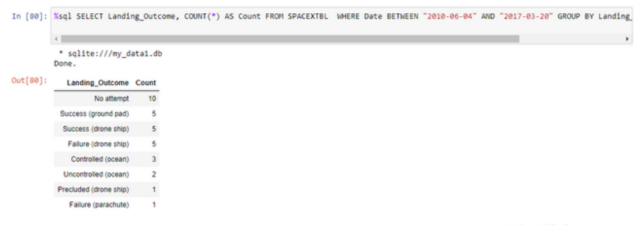
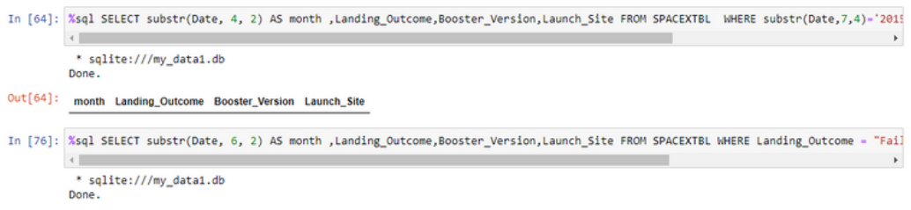
EDA with SQL
Using SQL, we had performed many queries to get better understanding of the dataset, Ex: - Displaying the names of the launch sites.
Displaying 5 records where launch sites begin with the string ‘CCA’. –
Displaying the total payload mass carried by booster launched by NASA (CRS).
Displaying the average payload mass carried by booster version F9 v1.1.
Listing the date when the first successful landing outcome in ground pad was achieved.
Listing the names of the boosters which have success in drone ship and have payload mass greater than 4000 but less than 6000. - Listing the total number of successful and failure mission outcomes.
Listing the names of the booster_versions which have carried the maximum payload mass.
Listing the failed landing_outcomes in drone ship, their booster versions, and launch sites names for in year 2015. - Rank the count of landing outcomes or success between the date 2010-06-04 and 2017-03-20, in descending order.

Slide 14
Build an Interactive Map with Folium
To visualize the launch data into an interactive map. We took the latitude and longitude coordinates at each launch site and added a circle marker around each launch site with a label of the name of the launch site. We then assigned the dataframe launch_outcomes(failure,success) to classes 0 and 1 with Red and Green markers on the map in MarkerCluster(). We then used the Haversine’s formula to calculated the distance of the launch sites to various landmark to find answer to the questions of:
How close the launch sites with railways, highways and coastlines?
How close the launch sites with nearby cities?

Slide 15
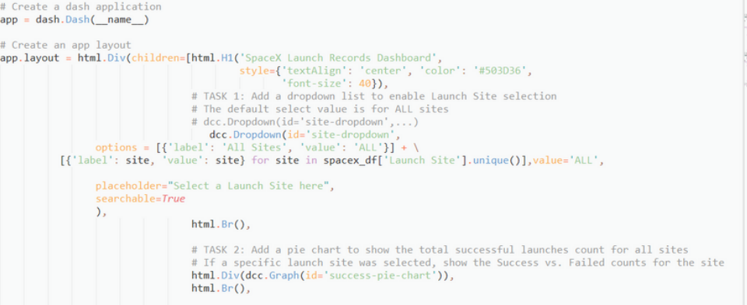
Build a Dashboard with Plotly Dash
We built an interactive dashboard with Plotly dash which allowing the user to play around with the data as they need.
We plotted pie charts showing the total launches by a certain sites.
We then plotted scatter graph showing the relationship with Outcome and Payload Mass (Kg) for the different booster version.

Slide 16
Predictive Analysis (Classification)
Building the Model
Load the dataset into NumPy and Pandas
Transform the data and then split into training and test datasets
Decide which type of ML to use set the parameters and algorithms to GridSearchCV and fit it to dataset.
Evaluating the Model
Check the accuracy for each model
Get tuned hyperparameters for each type of algorithms.
Plot the confusion matrix.

Slide 17
Predictive Analysis (Classification)
Improving the Model
Use Feature Engineering and Algorithm Tuning
Find the Best Model
The model with the best accuracy score will be the best performing model.

Slide 18

Section 2

Slide 19
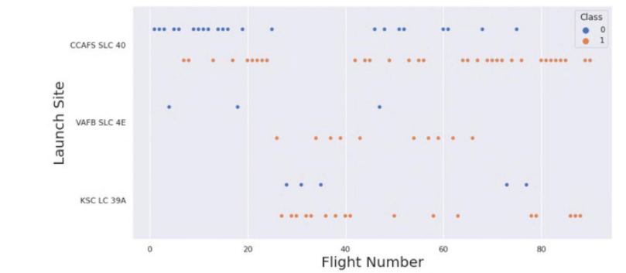
Flight Number vs. Launch Site
This scatter plot shows that the larger the flights amount of the launch site, the greater the the success rate will be. However, site CCAFS SLC40 shows the least pattern of this.

Slide 20
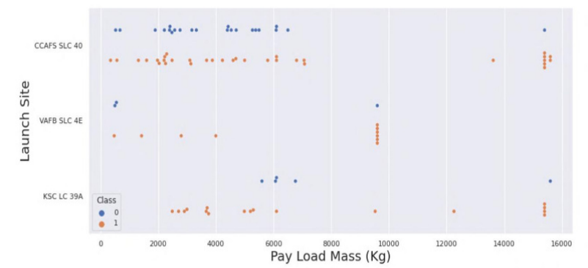
Payload vs. Launch Site
This scatter plot shows once the pay load mass is greater than 7000kg, the probability of the success rate will be highly increased. However, there is no clear pattern to say the launch site is dependent to the pay load mass for the success rate.

Slide 21
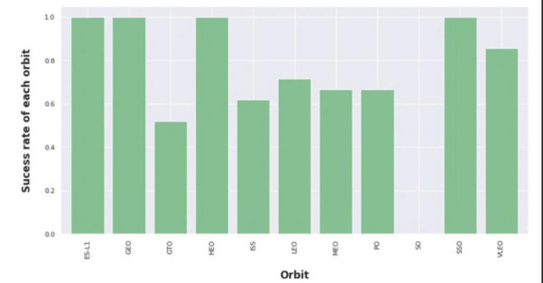
Success Rate vs. Orbit Type
This figure depicted the possibility of the orbits to influences the landing outcomes as some orbits has 100% success rate such as SSO, HEO, GEO AND ES-L1 while SO orbit produced 0% rate of success. However, deeper analysis show that some of this orbits has only 1 occurrence such as GEO, SO, HEO and ES-L1 which mean this data need more dataset to see pattern or trend before we draw any conclusion.

Slide 22
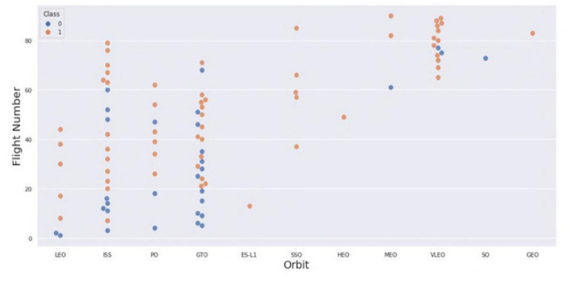
Flight Number vs. Orbit Type
This scatter plot shows that generally, the larger the flight number on each orbits, the greater the success rate (especially LEO orbit) except for GTO orbit which depicts no relationship between both attributes. Orbit that only has 1 occurrence should also be excluded from above statement as it’s needed more dataset.

Slide 23
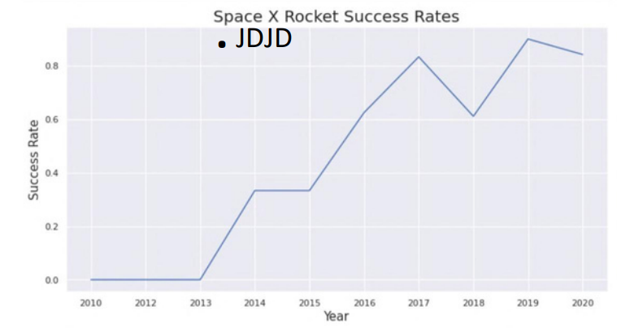
Launch Success Yearly Trend
This figures clearly depicted and increasing trend from the year 2013 until 2020. If this trend continue for the next year onward. The success rate will steadily increase until reaching 1/100% success rate.

Slide 24
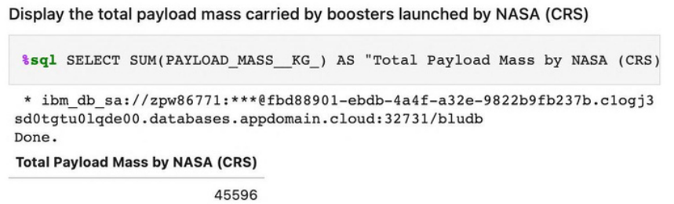
Total Payload Mass
We calculated the total payload carried by boosters from NASA as 45596 using the query ABOVE

Slide 25
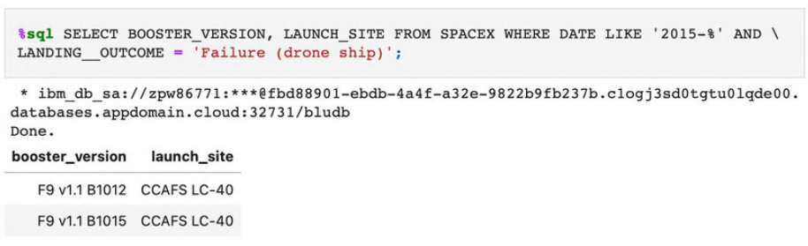
2015 Launch Records
We used a combinations of the WHERE clause, LIKE, AND, and BETWEEN conditions to filter for failedlanding outcomes in drone ship, their booster versions, andlaunch site names for year 2015

Slide 26
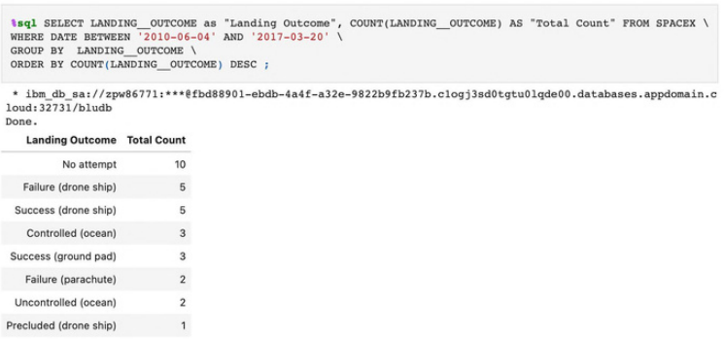
Rank Landing Outcomes Between 2010-06-04 and 2017-03-20
We selected Landing outcomes and the COUNT of landing outcomes from the data and used the WHERE clause to filter for landing outcomes BETWEEN2010-06-04 to 2010-03-20.
We applied the GROUP BY clause to group the landing outcomes and the ORDER BY clause to order the grouped landing outcome in descending order.

Slide 27

Section 3

Slide 28
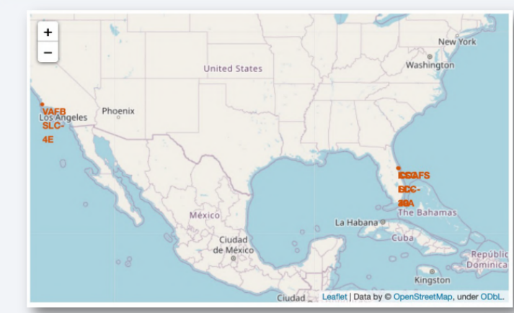
Launch Site Location

Slide 29
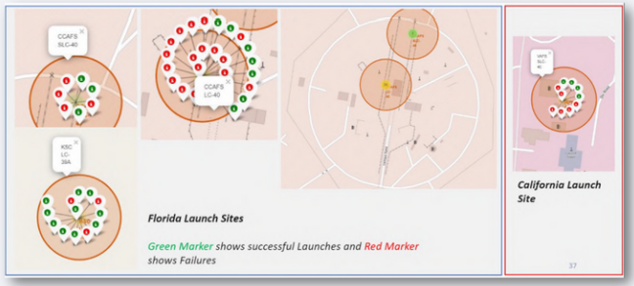
Markers showing launch sites with color labels

Slide 30
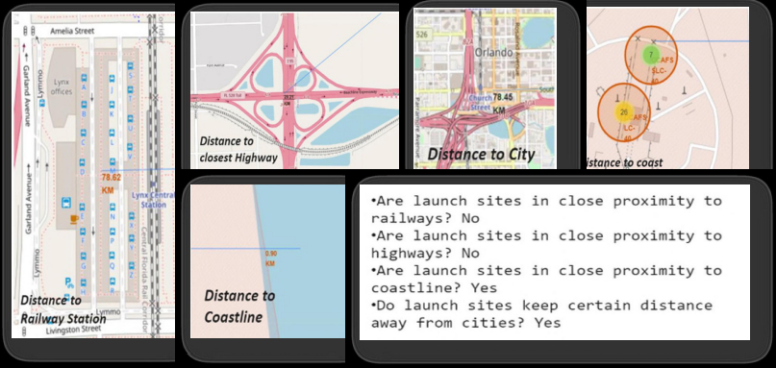
Launch Sites Distance to Landmarks

Slide 31

Section 4

Slide 32
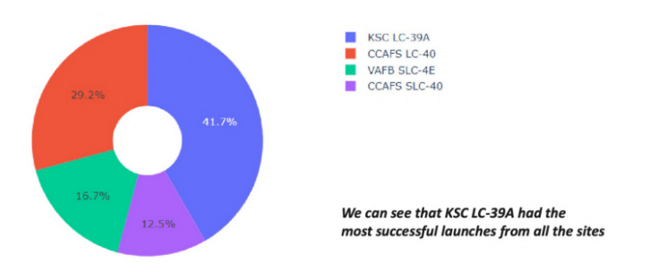
The success percentages by each site:

Slide 33
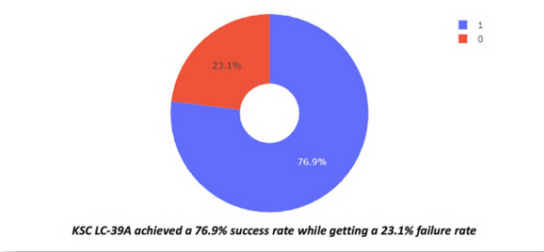
Highest success rate

Slide 34
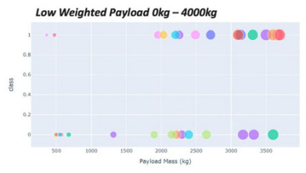
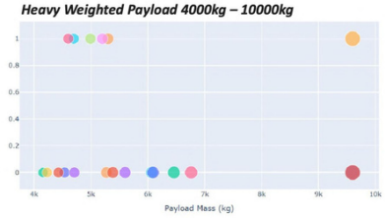
Payload vs Launch Outcome Scatter Plot
Success rate for low weighted payload is higher than heavy weighted payload

Slide 35

Section 5

Slide 36
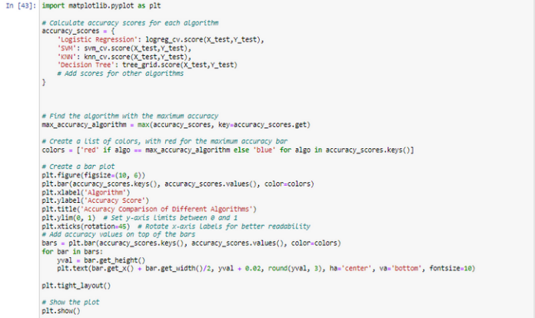
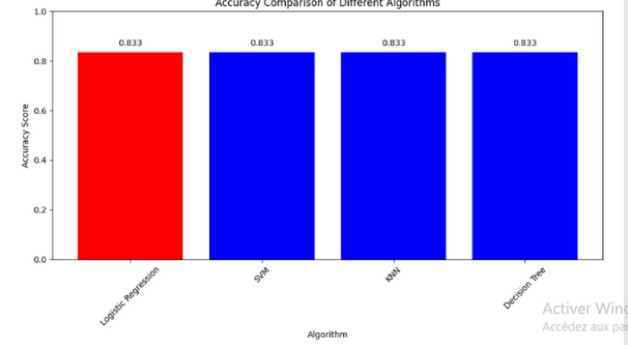
Classification Accuracy

Slide 37
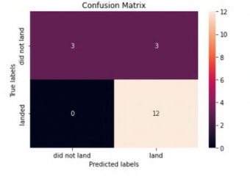
Confusion Matrix
The confusion matrix for the decision tree classifier shows that the classifier can distinguish between the different classes. The major problem is the false positives .i.e., unsuccessful landing marked as successful landing by the classifier.

Slide 38

Conclusions
The Tree Classifier Algorithm is the best Machine Learning approach for this dataset.
The low weighted payloads (which define as 4000kg and below) performed better than the heavy weighted payloads.
Starting from the year 2013, the success rate for SpaceX launches is increased, directly proportional time in years to 2020, which it will eventually perfect the launches in the future.
KSC LC-39A have the most successful launches of any sites; 76.9% SSO orbit have the most success rate; 100% and more than 1 occurrence.

Slide 39


